Slide 1

IT resources – TSF-Z
Javier Arregui
Director of TSF Zaragoza – Alliance Healthcare
javier.arregui@alliance-healthcare.net
27th October 2014
VII ProCOM 2014

Slide 2
Who we are?
I promise to be fast!

Slide 3
Who we are?
Simplification – not official!
Old “Safa Galénica”, based in Zaragoza, was part of “Grupo Safa” with Spanish national coverage.
“Grupo Safa” is now Alliance Healthcare Spain
Alliance Healthcare Spain is part of Alliance Healthcare:
  Pharmaceutical Wholesale business (mainly)
  Presence in +17 countries (Europe + Russia, China, Egypt…)
Alliance Healthcare division is part of Alliance Boots, merge between Alliance Healthcare and Boots UK:
    Health and Beauty Retail business
    Mainly in UK, but also Thailand, US, Gulf, …
  Alliance Boots is in process of merge with Walgreens (US biggest pharmacy chain) to become Walgreens Boots Alliance.
  My team, TSF-Z, is part of Alliance Healthcare division, working from Zaragoza for all AB from Zaragoza.

Slide 4
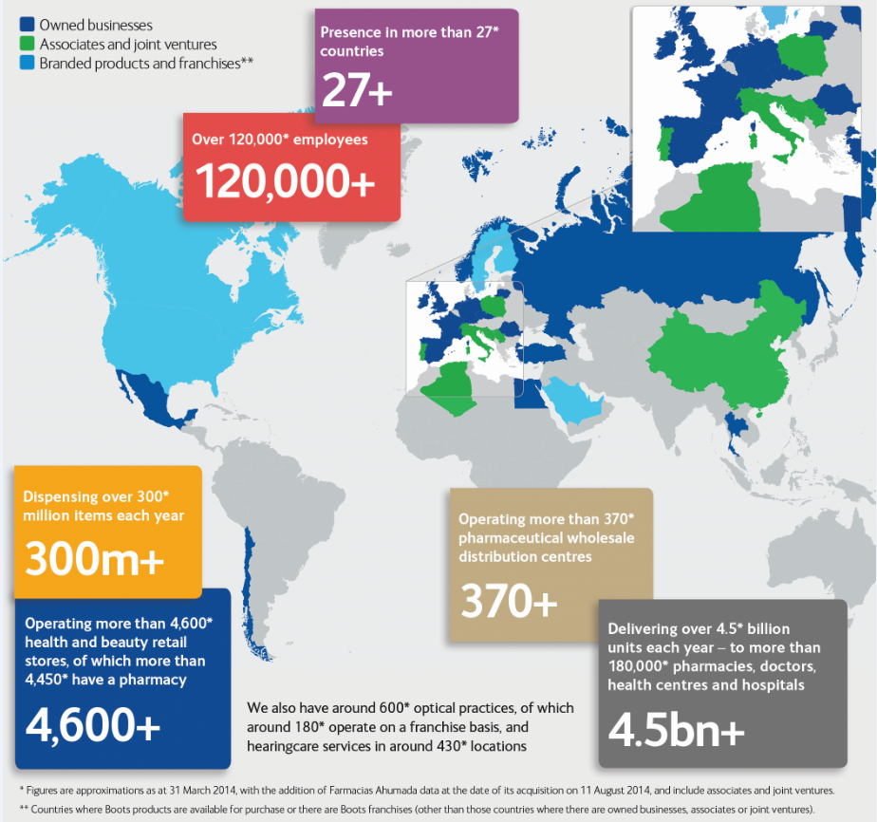
Alliance Boots figures

Slide 5
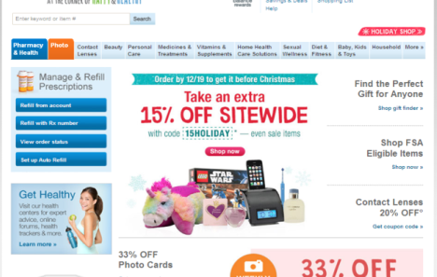
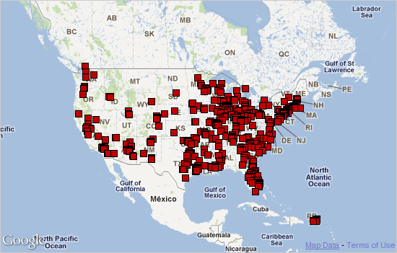
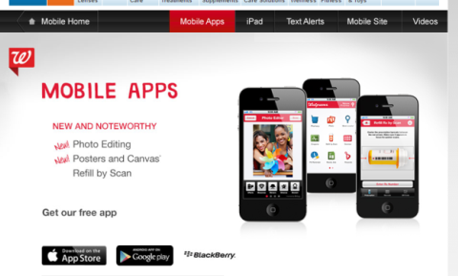

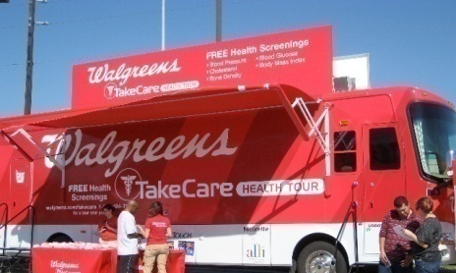
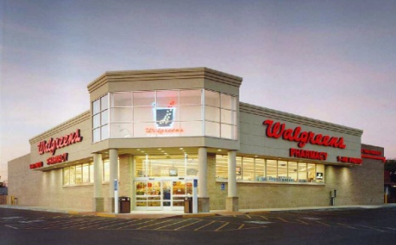
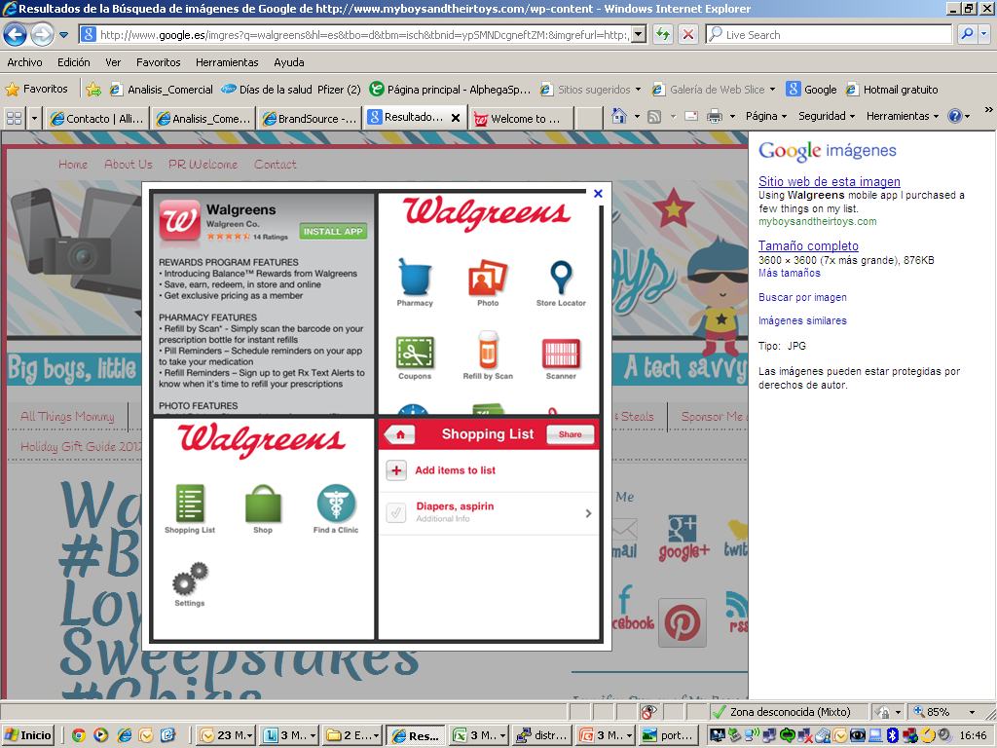




Walgreens figures
247.000+
Empleados
6.000.000
Clientes por día
50 Estados
Todos los estado USA además de Columbia y Puerto Rico
7890+
Puntos de venta (drugstore) . Todo USA, Columbia y Puerto Rico
819 millones+
Prescripciones en FY11
1ª
Cadena de Farmacias en USA

Slide 6

The Software Factory of Zaragoza
Mission and goals
The Software Factory of Zaragoza
The new internal Software Factory for Alliance Boots
Our mission: to deliver the most efficient and innovative development service for Alliance Boots in our 4 competence areas:
  Integration
  Web
  Mobile
  Business Intelligence
Our main goals:
  To provide the best possible “value for money”
  To guarantee quality and adherence to standards
  To boost synergies and code reusability
  To drive and support innovation

Slide 7
TSF-Z Competence areas
Main standard technologies
Integration
Software AG
TalenD (legacy)
Datastage (legacy)
Web / eCommerce
J2EE
Liferay
Magento
AngularJS
Mobile
PhoneGap
Ionic
AngularJS
REST (Java, Node.js)
BI
QlikView
DWH
NoSQL
Development and support
Constantly-evolving portfolio, new technologies to be tested and potentially incorporated

Slide 8
TSF Zaragoza Resource model
Core skills are kept internally. Key knowledge about projects is maintained secured within the team, avoiding vendor locking.
Minimum number of internal FTE, allowing for a sustainable team under low workload conditions.
International team with internal members located in several countries across Europe.
Variable workload managed through a flexible pool of resources from local selected Spanish partners with past experience in Alliance Boots projects.
Strategic principles of the resource model
8

Slide 9
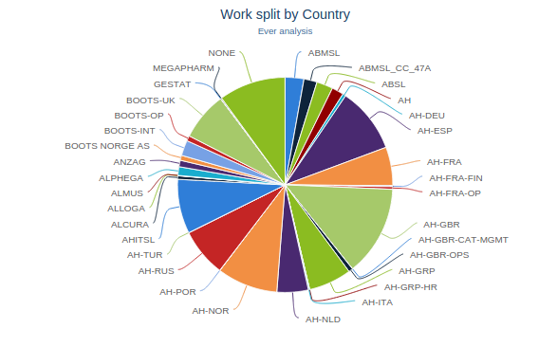
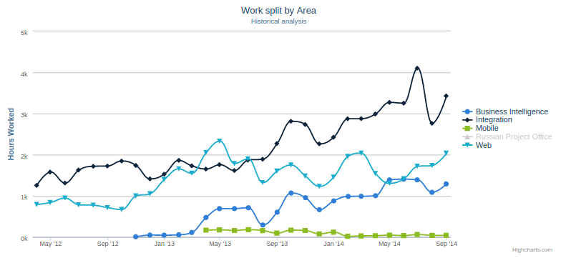
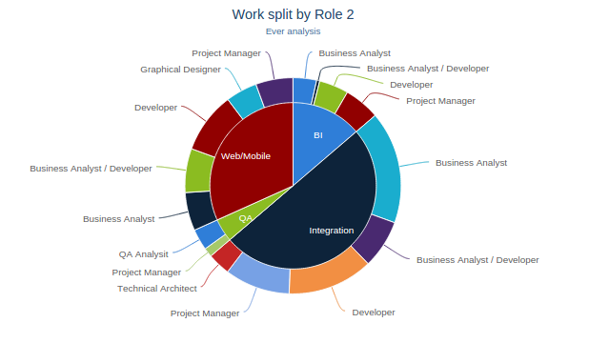
TSF-Z metrics
Working for all AH and Boots business entities
Clear growing tendency, this will enable dayrate reduction
Detailed profile analysis – interesting results per area

Slide 10
Key messages
We only recruit through our partners, Hiberus and Keensoft.
Strong future career opportunities.
English language skills are absolutely mandatory. We work in a trully international environment.
Technologies we’re interested in, split into “stable” and “quickly evolving”.
  Stable:
    Software AG
    QlikView
    Liferay
    Magento
  Quickly evolving:
    AngularJS
    Ionic.js
    Node.js
    Tools like git, bower, grunt…
    NoSQL
    For these, ideal profile would be a person with proven experience collaborating in open source projects in github, profficient in Javascript and distributed team work.

Slide 11
Happy to answer any question at javier.arregui@alliance-healthcare.net
Thanks!

